Slide 1


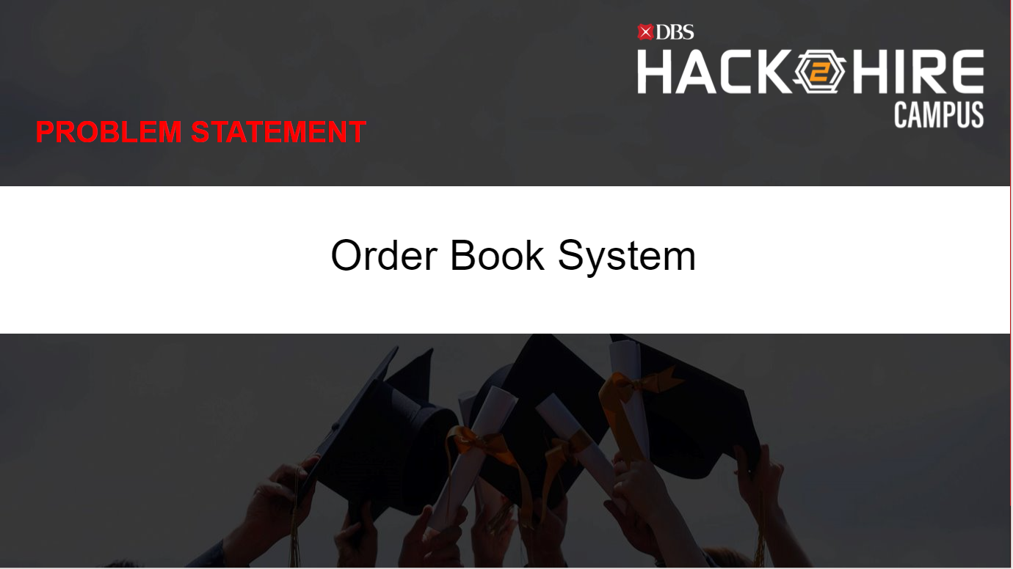

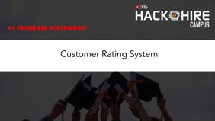
Challenges:

Slide 2
#1 PROBLEM STATEMENT
Customer Rating System

Slide 3

MOTIVATION
Every bank runs on trust of its customer and it is equally important for a bank to maintain reputation in the market. One scam or money laundering activity could make any bank reputation to go on toss, to avoid such situation as a bank it is so much important to know the nature of the customer i.e what kind of business customer is doing , what are the most incoming and outgoing transaction origin for a customer etc.
Our business problem is to identify each customer real time transaction and based on that do risk rating of the customer, as an operational person I should be able to see HIGH RISK rating customer , MEDIUM RISK rating customer and LOW RISK rating customer.
So that review/monitoring should be initiated for the HIGH RISK & MEDIUM RISK customers.

Slide 4
DELIVERABLES
The application can be a mobile or web application.
The app should provide an interface to configure ( delete , add and update) rules and capability to display latest rules on UI.
The app should have ability to read input data of customer from csv, read rules from DB , apply the rules , store output in DB and display each customer risk rating on UI with some advance filter (i.e: get customer by name, cust_id )
Highlight HIGH risk rated customers in red, MEDIUM in blue & LOW in yellow on UI.
Note:
Languages can be used: C++, Java, Python, .NET
Below points are good to have (Optional):
Visualize the customer segmentation(Cluster) based on risks(High, Medium and Low). (Chart Type - Cluster)
Visualize the count of customers based on risks(High, Medium and Low) in country level. (Chart Type - Scatter plot on customer, Countries as X-axis and Risk Type in Y-axis)
Display the Top-5 country names with maximum number of high-risk customers. (Chart Type: Bar Char)
Display the Bottom-5 country names with very a smaller number of low-risk customers. (Chart Type: Bar Char)
Note: Feel free to use Excel sheet or Python-Matplotlib (preferred one) for the visualization.

Slide 5
Rules To Mark Customer Risk Rating:
If customer met any of the criteria corresponding to risk each risk category should be marked as customer risk rating accordingly.
HIGH RISK | MEDIUM RISK | LOW RISK
H1: If there are more than 10 incoming or outgoing (INN | OUT) transaction in a month from high risk country. | M1: If there more than 6 incoming or outgoing (INN | OUT) transaction in a month from high risk/Non-high country. | L1: If there less than 10 incoming or outgoing (INN | OUT) transaction in a month from non-high-risk country.
H2: If sum of all incoming(INN) transaction is more than 1000$ in a month. | M2: If sum of all incoming(INN) transaction is more than 600$ and less than 1000$ in a month. | L2: If sum of all incoming(INN) transaction is less than 600$ in a month.
H3: If sum of all outgoing (OUT) transaction is more than 800$ in a month. | M3: If sum of all outgoing (OUT) transaction is more than 500$ and less than 800$ in a month. | L3: If sum of all outgoing (OUT) transaction is less than 500$ in a month.
H4: If number of transaction in a day is more than 20. | M4: If number of transaction in a day is more than 10 but less than 20. | L4: If number of transaction in a day is less than 10.

Slide 6
Customer Data Details:
Customer_info.csv: This data source contains customer information like customer_key unique id of the customer , customer_name it is self explanatory i.e name of the customer, customer_residential_country where customer is currently residing.
Customer_account.csv: This data source contains account information of a country like customer_key unique customer id, account_key unique account number of the customer, account_open_date on which the account has been opened.
Countries_info.csv: This data source contains high risk countries codes in a column country_code.
Customer_transactions.csv: This data source contains transaction details for each account. Column details: Transfer_Key, Account_Key, Transaction_Amount(in $), Transaction_Type, Transaction_Origin/Destination, Transaction_Date

Slide 7
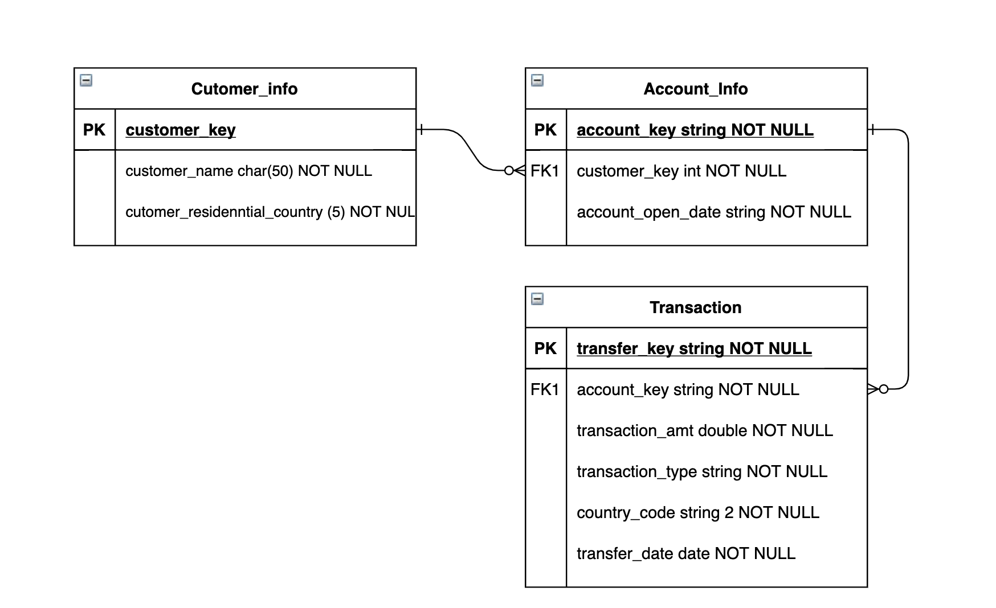
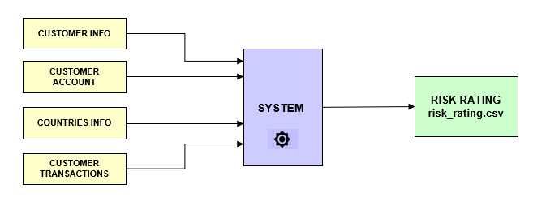
Architecture Diagram:
Entity Relationship Diagram:
(DB)
OUTPUT | Customer Name
 | Residential Country
 | Risk Rating
 | Risk Rating Reason
HIGH/MEDIUM/LOW
Which criteria customer has met? H1/M2/L3 etc.

Slide 8
Software Prerequisites:
Install the appropriate editors for languages of your choice. Ex:
Eclipse Editor for Java/C++
Visual Studio Code for C++/Python/.NET
PyCharm , Spyder for Python
Install any of the open-source databases. Ex:
MySQL
MariaDB
SQLite
Install any of below Framework for Front-end Javascript or framework of your choice ex
NodeJs, Angular 9+
4. Need to upload the code base to GitHub repository, so that codes can be integrated with other teammates.Public Repository should be created and shared to team .

Slide 9
SCORING CRITERIA
Screen | Weightage
UI | 20
Business Logic + API / Services | 40
End to End Integration | 20
Additional Bonus | 10
Additional Bonus points will be awarded for any extra implementation including but not limited to data validation, usability, user interface.

Slide 10
PROBLEM STATEMENT
Order Book System

Slide 11
INTRODUCTION
The problem statement is focused on building a workable Order-Book Management System.
The term Order-Book refers to an electronic list of buy and sell orders for a specific financial instrument like stocks.
System will have 2 kind of Users – Admin and Customers.
Customers can place new order for stocks purchasing when market is open and Admin can execute the orders when market is closed.
The market open/close action will be handled by Admin. Once market is closed, no new orders can be placed by Customers
When the market is closed , Admin has to ‘execute’ the orders . Detailed logic is provided in next slides.
The system focus on only Buying the financial instrument .

Slide 12
DELIVERABLES
The application can be a mobile or web application.
The app should provide screens to accept customer data.
The app should provide screens to display orders and execute order for Admin user
The app should have some persistent storage to store order information and corresponding service API to connect to front-end
The app should user REST wherever required and be API & Components Driven. Java is recommended not mandatory though

Slide 13
Business Requirements
System manages Order-Books. Each stock has specific stock Id and every order book deals with only one kind of Stock. I.e. every stock will have its own Order-book.
There are 2 Users for System – Customer and Admin. Admin can OPEN/CLOSE the Market. Customer can place new order for any stock when market is open. System should not accept any order when ADMIN close the market.
An Order is defined by Quantity, order date, stock Id and Price.
There are 2 Types of Order : Market Order and LIMIT Order. Limit order has a specified Price whereas Market orders are request for best price and Customer doesn’t provide Price for the Order
When ADMIN Close the Market, Orders can be processed. Admin can select the stock and see all the orders for the day.
ADMIN Execute order in chunks. Every Executions of order will accept 2 inputs – Execution Qty and Execution Price.
If Execution is added , some orders become REJECTED – if order is LIMIT order and its order price is lower than Execution price. All subsequent Execution will have same execution price. Execution price cant change
The Execution Quantity should be distributed linearly among all accepted order . ACCEPTED Order i.e. all market orders and where LIMIT Order price is greater or equal than Processing Price
System should accept execution till all ACCEPTED Orders gets processed for specific Stock.

Slide 14
Book Order – Customer Screen
Search Stock
This should be Select Dropdwon input field to see pre-defined stocks list . Customer can select a stock name here. Each stock is tied to its Stock ID
DBS…
Order Type
Input type Select Dropdown with 2 values ‘LIMIT’ or ’MARKET’. If limit order is selected, then customer has to provide Price in next price field and its mandatory for LIMIT order. For MARKET order type , PRICE field becomes disabled and not required
Limit or Market
Price
Price for Market Order.
150.00
Quantity
Quantity of order .Must be a positive integer
10
Submit button for placing order. This should be enabled only when Market is OPEN by ADMIN User. By default it should be disabled . If market is OPEN , On submitting this form,Customer should be shown some message to inform that Order placed successfully.
Place Order

Slide 15
Admin Screen-1
Buttons to OPEN/CLOSE the Market.
Open Market
CLOSE Market
Date Picker and Stock select Filters to Show all orders.. Order status can be PLACED, PROCESSED,ACCEPTED and REJECTED
Select Stock
From Date
To Date
Show Orders
DBS…
S.No. | Stock Name | Order Qty | Order Type | Executed Qty | Price | Order Status | Order Date
1 | DBS | 50 | Limit | 0 | 150 | PLACED | 21 Feb 2021
2 | DBS | 50 | Market | 0 |  | PLACED | 21 Feb 2021
3 | DBS | 50 | Limit | 0 | 140 | PLACED | 21 Feb 2021
Execution Qty
Execution Price
Execution Of Order will be accepted when Market is closed. Once execute orders is clicked.Table should refresh the data .
60
150
Execute Orders

Slide 16
Admin Screen-2
OPEN Market
CLOSE Market
Buttons to OPEN/CLOSE the Market.
Select Stock
From Date
To Date
Show Orders
Date Picker and Order status Filters to Show all orders.. Order status can be PLACED, PROCESSED,ACCEPTED and REJECTED
DBS…
S.No. | Stocks Name | Order Qty | Order Type | Executed Qty | Price | Order Status | Order Date
1 | DBS | 50 | Limit | 30 | 150 | ACCEPTED | 21 Feb 2021
2 | DBS | 50 | Market | 30 |  | ACCEPTED | 21 Feb 2021
3 | DBS | 50 | Limit | 0 | 140 | REJECTED | 21 Feb 2021
Execution Qty
Execution Price
After First Execution, 3rd order became rejected and execution qty distributed uniformly among all accepted orders i.e. 30 each.
40
150
Execute Orders

Slide 17
Admin Screen-3
Open Market
CLOSE Market
Buttons to OPEN/CLOSE the Market.
Select Stock
From Date
To Date
Show Orders
DBS…
S.No. | Stocks Name | Order Qty | Order Type | Executed Qty | Price | Order Status | Order Date
1 | DBS | 50 | Limit | 50 | 150 | EXECUTED | 21 Feb 2021
2 | DBS | 50 | Market | 50 |  | EXECUTED | 21 Feb 2021
3 | DBS | 50 | Limit | 0 | 140 | REJECTED | 21 Feb 2021
Execution Qty
Execution Price
After second execution , both the ACCEPTED orders quantity has been completed and status changes to EXECUTED. After this no new execution can be submitted .
Execute Orders

Slide 18

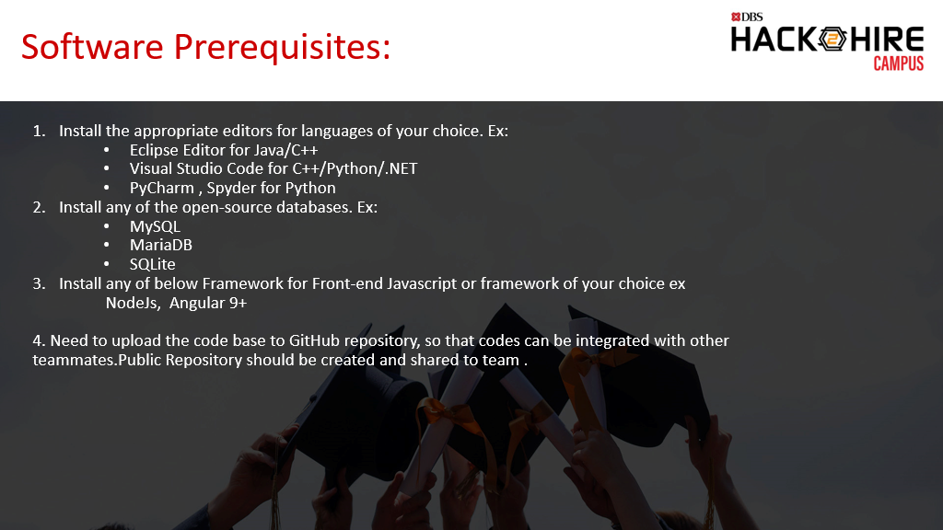

Slide 19
SCORING CRITERIA
Screen | Weightage | Admin | Customers
UI | 20 | 10 | 10
Business Logic + API / Services | 40 | 20 | 20
End to End Integration | 20 | 10 | 10
Additional Bonus | 10
Additional Bonus points will be awarded for any extra implementation including but not limited to data validation, usability, user interface.

